Slide 1
CORE JAVA

Slide 2
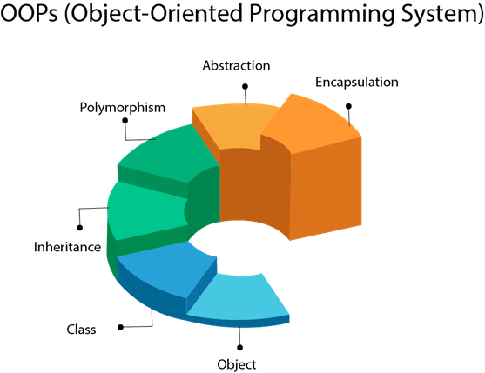
OBJECT –ORIENTED PROGRAMMING
Objects and classes
Data abstraction and Encapsulation
Inheritance
Polymorphism
Compile time and runtime Mechanism
Dynamic Binding
Message Communication

Slide 3
What is a class
Collection of objects is called class. It is a logical entity.
A class can also be defined as a blueprint from which you can create an individual object. Class doesn't consume any space.
Syntax:
class <classname>
{
fields declaration;
methods declaration;
}
Room? object
Objects?

Slide 4
Data abstraction and Encapsulation
Abstraction is the concept of object-oriented programming that "shows" only essential attributes and "hides" unnecessary information. The main purpose of abstraction is hiding the unnecessary details from the users. Abstraction is selecting data from a larger pool to show only relevant details of the object to the user. It helps in reducing programming complexity and efforts. It is one of the most important concepts of OOPs.
Encapsulation is one of the fundamental concepts in object-oriented programming (OOP). It describes the idea of bundling data and methods that work on that data within one unit, e.g., a class in Java.
This concept is also often used to hide the internal representation, or state, of an object from the outside. This is called information hiding. The general idea of this mechanism is simple. If you have an attribute that is not visible from the outside of an object, and bundle it with methods that provide read or write access to it, then you can hide specific information and control access to the internal state of the object.

Slide 5
Inheritance
Inheritance in java is a mechanism in which one object inherits all the properties and behaviors of parent object.
We use inheritance for :
For Method Overriding (so runtime polymorphism can be achieved).
For Code Reusability.
--When one object acquires all the properties and behaviors of a parent object, it is known as inheritance. It provides code reusability. It is used to achieve runtime polymorphism.

Slide 6

Polymorphism
Polymorphism is the ability of an object to take on many forms. The most common use of polymorphism in OOP occurs when a parent class reference is used to refer to a child class object.
Types of polymorphism
Compile-time polymorphism // method overloading
Run-time polymorphism // method overriding

Slide 7
First code in JAVA
To create a simple java program, you need to create a class that contains the main method.
Let's understand the requirement first.
For executing any java program, you need to
Install the JDK if you don't have installed it, download the JDK and install it.
Set path of the jdk/bin directory.
Create the java program
Compile and run the java program
class Simple{
public static void main(String args[]){
System.out.println("Hello Java");
}
}

Slide 8
Breaking Down the code
class keyword is used to declare a class in java.
public keyword is an access modifier which represents visibility. It means it is visible to all.
static is a keyword. If we declare any method as static, it is known as the static method. The core advantage of the static method is that there is no need to create an object to invoke the static method. The main method is executed by the JVM, so it doesn't require to create an object to invoke the main method. So it saves memory.
void is the return type of the method. It means it doesn't return any value.
main represents the starting point of the program.
String[] args is used for command line argument. We will learn it later.
System.out.println() is used to print statement. Here, System is a class, out is the object of PrintStream class, println() is the method of PrintStream class.

Slide 9
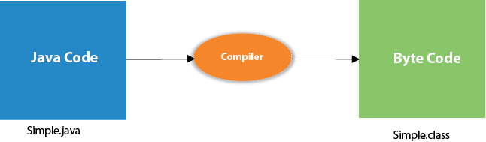
Simple JAVA Program
save this file as Simple.java
To compile: | javac Simple.java
To execute: | java Simple
Compilation Flow:
When we compile Java program using javac tool, java compiler converts the source code into byte code.

Slide 10
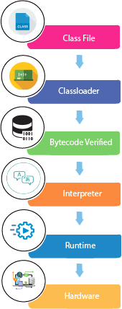
What happens at run time

Slide 11
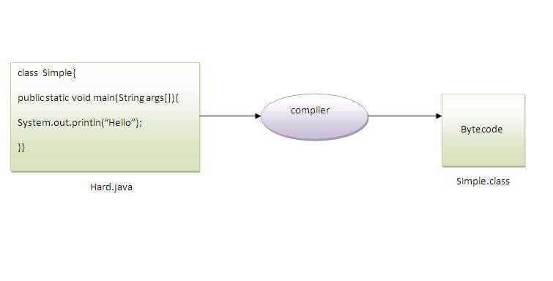
Save a java source file by other name
Yes, if the class is not public. It is explained in the figure given below:
To compile: | javac Hard.java
To execute: | java Simple

Slide 12
Memory management in java
Heap: It is created by the Java Virtual Machine when it starts. The memory is used as long as the application is running. Java runtime uses it to allocate memory to objects and Java Runtime Environment (JRE) classes.
Young generation
Old generation
Garbage collection
Stack: This is the temporary memory where variable values are stored when their methods are invoked. After the method is finished, the memory containing those values is cleared to make room for new methods.
When a new method is invoked, a new block of memory will be created in the Stack. This new block will store the temporary values invoked by the method and references to objects stored in the Heap that are being used by the method.

Slide 13
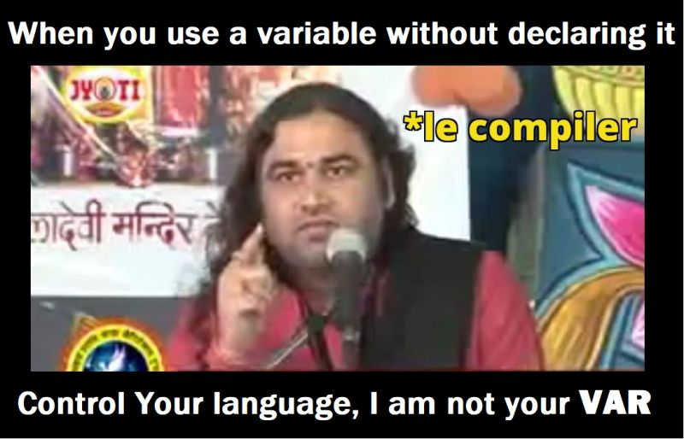
Core concepts: Variables and identifiers
A variable is a container which holds the value while the Java program is executed. A variable is assigned with a data type.
Variable is a name of memory location. There are three types of variables in java: local, instance and static.
Variable is name of reserved area allocated in
memory. In other words, it is a name of memory
location.
It is a combination of "vary + able" that means its
value can be changed.

Slide 14
Types of variables:
There are three types of variables in Java:
1) Local Variable
A variable declared inside the body of the method is called local variable. You can use this variable only within that method and the other methods in the class aren't even aware that the variable exists.
A local variable cannot be defined with "static" keyword.
2) Instance Variable
A variable declared inside the class but outside the body of the method, is called instance variable. It is not declared as static.
It is called instance variable because its value is instance specific and is not shared among instances.

Slide 15
Types of variables:
3) Static variable
A variable which is declared as static is called static variable. It cannot be local. You can create a single copy of static variable and share among all the instances of the class. Memory allocation for static variable happens only once when the class is loaded in the memory.
class A{
int data=50;//instance variable
static int m=100;//static variable Class Student
void method(){
int n=90;//local variable
}
}//end of class

Slide 16
Standard output
System.out: This is the standard output stream that is used to produce the result of a program on an output device like the computer screen.
Different functions with System.out
print()
println()
printf()

Slide 17
Standard input:
System.in: This is the standard input stream that is used to read characters from the keyboard or any other standard input device.
Scanner class: Scanner is a class in java.util package used for obtaining the input of the primitive types like int, double, etc. and strings. It is the easiest way to read input in a Java program.
Example:
Scanner sc = new Scanner(System.in);
int i = sc.nextInt();

Slide 18
Coding Exercise for the session
read an integer, a double, and a String from stdin, then print the values
Sample Input
42
3.1415
Welcome to Java tutorials!
Sample Output
String: Welcome to Java tutorials!
Double: 3.1415
Int: 42
Take two Strings as input from user and concatenate the two strings, and print it.
Sample input: hello
class
Sample output: hello class

Slide 19
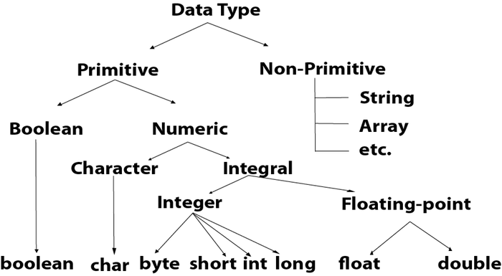
Data types in JAVA

Slide 20
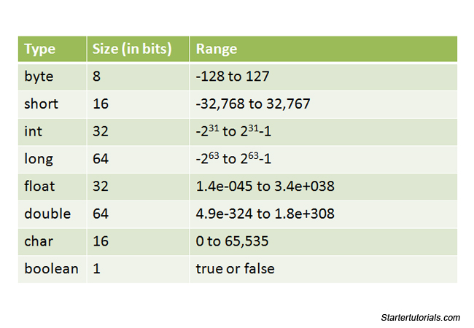
Data Types in Java

Slide 21
Type conversion (Widening)
Widening or type conversion means converting a smaller data type into a bigger size data type. i.e. Providing more space to a variable by converting it’s data type.
Example:
class Simple{
public static void main(String[] args){
int a=10; //Assigning value 10 to a variable “a” of int type
float f=a; // Assigning value of “a” to variable “f” which is of type float.
System.out.println(a);
System.out.println(f);
}}

Slide 22
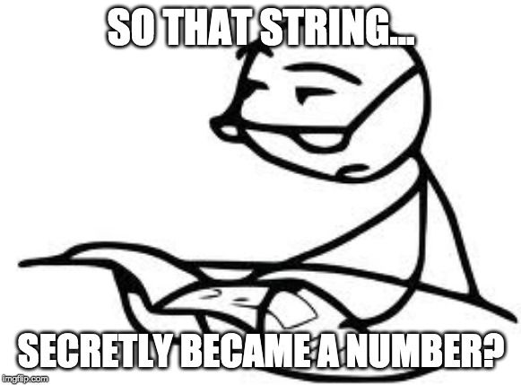
Type casting (Narrowing)
Type casting is a method in which you convert a bigger size data type into a smaller one.
Example:
class Simple{
public static void main(String[] args){
float f=10.5f;
//int a=f;//Compile time error // assigning float value to int value// larger value to smaller value
int a=(int)f;
System.out.println(f);
System.out.println(a);
}}

Slide 23
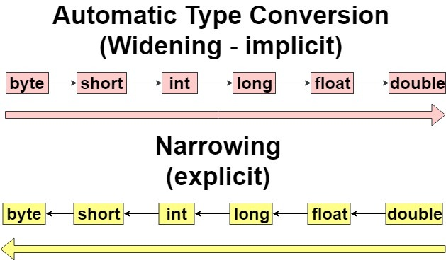
Type Promotion
Whenever evaluating a expression JAVA do some automating type conversions which is called type promotion.
Rule of automatic type conversion:
If evaluating expression with variables of type short or byte, result will automatically promoted to integer type.
If you are evaluating the expression having variables of multiple data type the result will always be stored in the variable with largest data type in expression.

Slide 24
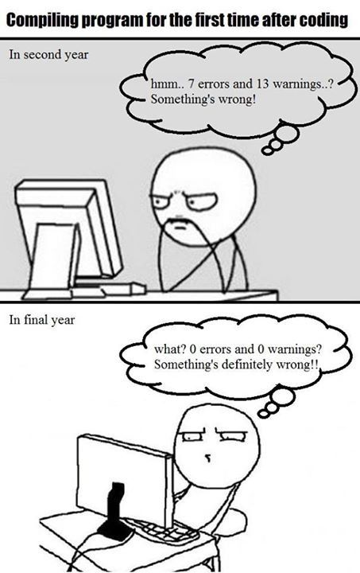
Coding exercise:
Write a Java program to convert temperature from Fahrenheit to Celsius degree.
Write a Java program to takes the user for a distance (in meters) and the time was taken (as three numbers: hours, minutes, seconds), and display the speed, in meters per second, kilometers per hour.

Slide 25
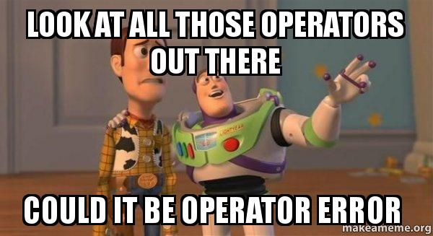
Operators in JAVA
Operators are symbols that perform operations on variables and values. For example, + is an operator used for addition, while * is also an operator used for multiplication.

Slide 26
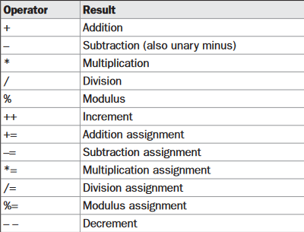
Arithmetic operators:

Slide 27
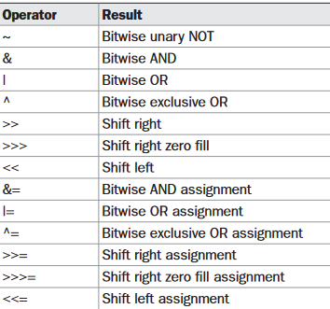
Bitwise Operators

Slide 28
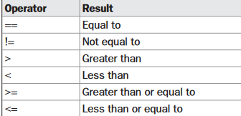
Relational operators

Slide 29
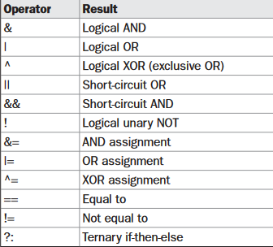
Boolean Logical operators

Slide 30
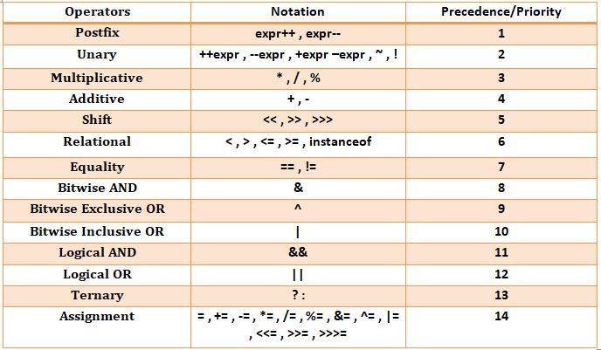
Precedence of operators java

Slide 31
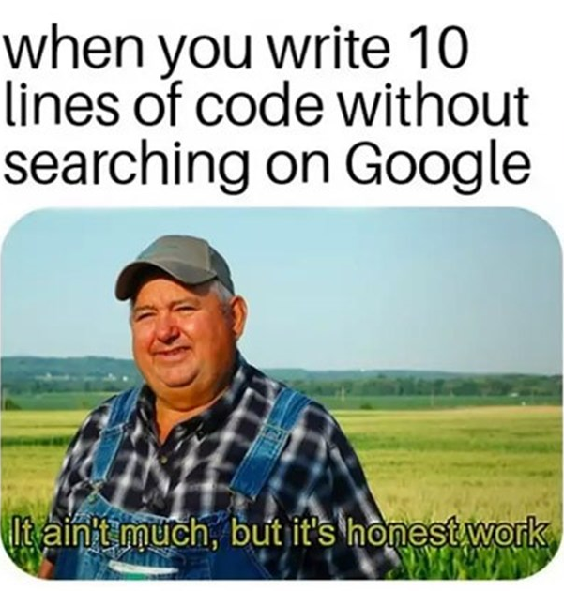
Practice questions:
The total number of students in a class are 90 out of which 45 are boys. If 50% of the total students secured grade 'A' out of which 20 are boys, then write a program to calculate the total number of girls getting grade 'A’.
Write a program to calculate the sum of the first and the second last digit of a 5 digit. E.g.- NUMBER : 12345 OUTPUT : 1+4=5
Write a program to reverse a 3-digit number without using an array. E.g.-Number : 132 Output : 231

Slide 32
Control Statements
programming language uses control statements to cause the flow of execution to advance and branch based on changes to the state of a program. Java’s program control statements can be put into the following categories: selection, iteration, and jump. Selection statements allow your program to choose different paths of execution based upon the outcome of an expression or the state of a variable. Iteration statements enable program execution to repeat one or more statements (that is, iteration statements form loops).
Types of control Statement :
1. Selection or Decision statements
2. Iterative Statements or looping statements.

Slide 33
Decision Constructs
If-else
Nested if else
If else ladder
Switch

Slide 34
Practice questions if else:
program that uses an if-else-if ladder to determine which season a particular month is in.
Check whether the number is even or odd.
Write a program to convert marks into grades
Where A grade>85; B grade>75; C grade> 65; D grade<65
Write a program to check whether the triangle is valid or not if angles are given
Take the amount from user and calculate the discount for user.
For the purchase below 25000 discount 5%
If the purchase is above 25000 discount is 20%
If the purchase is above 50000 discount is 40%

